Slide 1
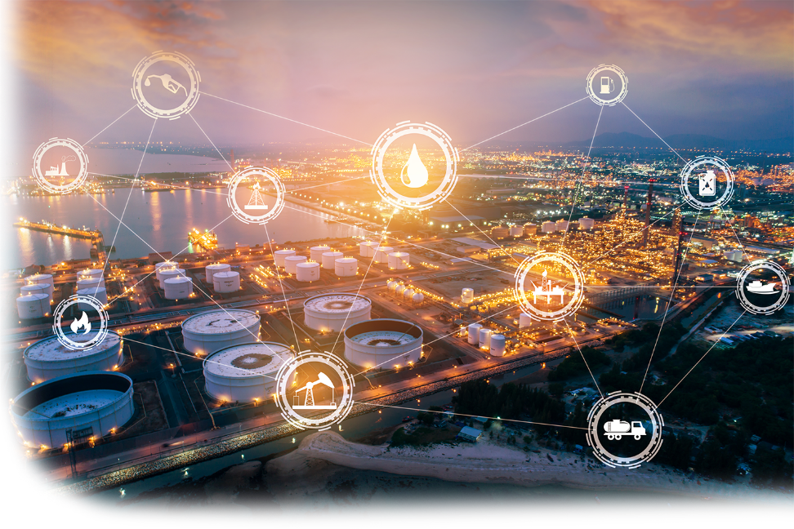


ThreatGEN.com | CyberSuperhuman.AI
REAL-WORLD CYBERSECURITY APPLICATIONS WITH GENERATIVE AI AND LLMs
CLINT BODUNGEN
DIRECTOR, CYBERSECURITY INNOVATION – MORGAN FRANKLIN CONSULTING
FOUNDER - THREATGEN
Notes:
I’m working with industrial defender to integrate AI features into their platform using private local models. The other use cases are from other ThreatGEN (undisclosed) customers with varying levels of integrations.

Slide 2

I can’t teach you everything in 45 minutes.
Cybersuperhuman.ai
HOUSECCON2024
(It’s free)
ThreatGEN.com | CyberSuperhuman.AI
https://github.com/R1ngZer0/GenAI-for-Cybersecurity
https://github.com/PacktPublishing/ChatGPT-for-Cybersecurity-Cookbook
_01
Notes:
Give a very brief explanation of how generative AI/LLMs extend ML.
Give a very brief overview of the common fears of using Generative AI and LLMs in production.
VERY briefly cover the difference between, applications, and limitations for ChatGPT, LLM APIs, and Open-Source Models.

Slide 3

The Truth About Generative AI_
It can’t do your job for you...
01
Yet.
You CAN it safely, in production.
02
Not instantly, anyway.
ThreatGEN.com | CyberSuperhuman.AI
You CAN use it safely, in production.
03
Keeping your data local and private.
You CAN avoid hallucinations.
04
RAG + Agents
(And don’t do drugs.)
_02
Notes:
Introduce real-world use cases/case-studies and show a short demo reel.

Slide 4
ThreatGEN.com | CyberSuperhuman.AI
Simple Use Cases_
_03
Notes:
This video runs through a very quick demo of a couple of 3 use cases. OT asset/network risk analysis. Network diagram analysis. Automated IR tabletop. (I wasn’t allowed to show the enhanced/automated asset onboarding yet.) I’ll mention specific techniques related to achieving these results as we go through the presentation and discuss techniques. I’ll also provide open-source scripts and information in my github repository.
(Should this maybe be at the very beginning? What’s the optimal way to present this on stage? Directly embedded? Link to a video file in the same location on the drive?)

Slide 5
Phishing Simulation_
"You are a cybersecurity professional and expert in adversarial social engineering tactics, techniques, and procedures, with 25 years of experience. Create an interactive email phishing training simulation (for employees). Provide no other response other than to ask the question, "Is the following email real or a phishing attempt? (You may ask clarification questions such as URL information, header information, etc.)" followed by simulated email, using markdown language formatting. The email you present can represent a legitimate email or a phishing attempt, which can use one or more various techniques. Provide no further generation or response until I answer the question. If I answer correctly, just respond with "Correct" and a short description to further explain the answer, and then restart the process from the beginning. If I answer incorrectly, respond with "Incorrect", then the correct answer, then a short description to further explain the answer. Then repeat the process from the beginning.
Present me with only 3 simulations in total throughout the process and remember my answer to them all. At least one of the simulations should simulate a real email. After the last question has been answered, and after your response, end the assessment and give me my total score, the areas I did well in and where I need to improve."
ThreatGEN.com | CyberSuperhuman.AI
_04
Notes:
This video runs through a very quick demo of a couple of 3 use cases. OT asset/network risk analysis. Network diagram analysis. Automated IR tabletop. (I wasn’t allowed to show the enhanced/automated asset onboarding yet.) I’ll mention specific techniques related to achieving these results as we go through the presentation and discuss techniques. I’ll also provide open-source scripts and information in my github repository.
(Should this maybe be at the very beginning? What’s the optimal way to present this on stage? Directly embedded? Link to a video file in the same location on the drive?)

Slide 6
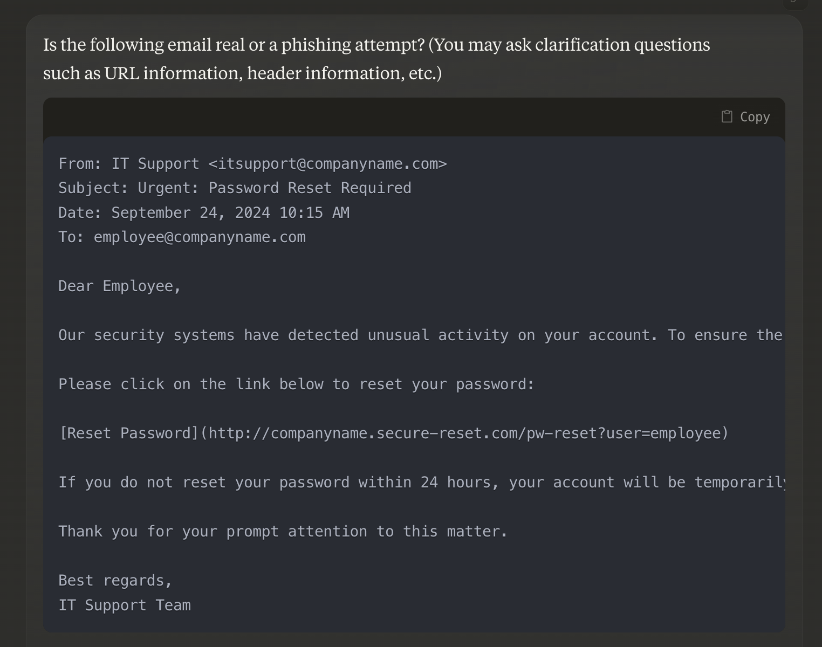
Phishing Simulation_
ThreatGEN.com | CyberSuperhuman.AI
_05
Notes:
This video runs through a very quick demo of a couple of 3 use cases. OT asset/network risk analysis. Network diagram analysis. Automated IR tabletop. (I wasn’t allowed to show the enhanced/automated asset onboarding yet.) I’ll mention specific techniques related to achieving these results as we go through the presentation and discuss techniques. I’ll also provide open-source scripts and information in my github repository.
(Should this maybe be at the very beginning? What’s the optimal way to present this on stage? Directly embedded? Link to a video file in the same location on the drive?)

Slide 7
Phishing Simulation_
"You are a cybersecurity professional with more than 25 years of experience and an expert in gamification and game-based training. You will be the game master for a cybersecurity themed role-playing game (RPG). The game is "Find the Insider Threat", a "who did it" mystery. The object is to interview staff and investigate systems to find the insider threat. I must do it in 50 turns or less. Keep score by adding and subtracting points as you see fit, as I go. If I find the culprit (I win) or after turn 50 the game is over (I lose). At that time, present me with my score, the game summary, my successes, my failures, and where I can improve (keeping in mind this is meant to be cybersecurity educational). When the game starts, present me with the scenario, setting, and game rules. Stay in character as the gamemaster, keep track of each turn (every prompt after you present the game scenario, setting, and rules, is a game turn). At the end of each of your responses after the game starts, you will remind me of the turn and my current score (score starts at 0). Use markdown language in your prompts, to make the presentation more interesting and more readable.
If you understand, start the game."
ThreatGEN.com | CyberSuperhuman.AI
_06
Notes:
This video runs through a very quick demo of a couple of 3 use cases. OT asset/network risk analysis. Network diagram analysis. Automated IR tabletop. (I wasn’t allowed to show the enhanced/automated asset onboarding yet.) I’ll mention specific techniques related to achieving these results as we go through the presentation and discuss techniques. I’ll also provide open-source scripts and information in my github repository.
(Should this maybe be at the very beginning? What’s the optimal way to present this on stage? Directly embedded? Link to a video file in the same location on the drive?)

Slide 8
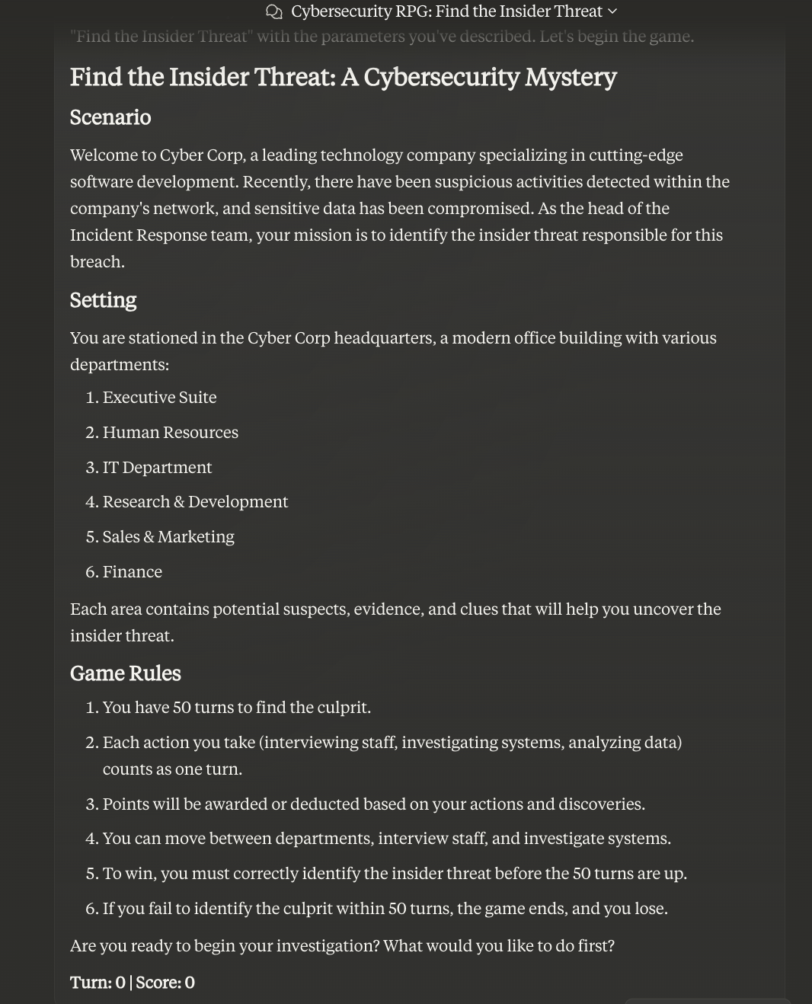
ThreatGEN.com | CyberSuperhuman.AI
Gamifying
Cybersecurity_
_07
Notes:
This video runs through a very quick demo of a couple of 3 use cases. OT asset/network risk analysis. Network diagram analysis. Automated IR tabletop. (I wasn’t allowed to show the enhanced/automated asset onboarding yet.) I’ll mention specific techniques related to achieving these results as we go through the presentation and discuss techniques. I’ll also provide open-source scripts and information in my github repository.
(Should this maybe be at the very beginning? What’s the optimal way to present this on stage? Directly embedded? Link to a video file in the same location on the drive?)

Slide 9
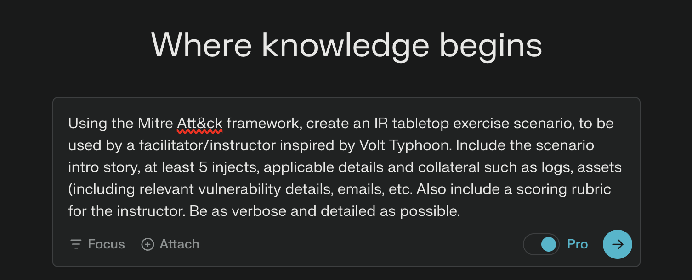
Tabletop Scenarios_
Using Perplexity.ai
ThreatGEN.com | CyberSuperhuman.AI
_08
Notes:
This video runs through a very quick demo of a couple of 3 use cases. OT asset/network risk analysis. Network diagram analysis. Automated IR tabletop. (I wasn’t allowed to show the enhanced/automated asset onboarding yet.) I’ll mention specific techniques related to achieving these results as we go through the presentation and discuss techniques. I’ll also provide open-source scripts and information in my github repository.
(Should this maybe be at the very beginning? What’s the optimal way to present this on stage? Directly embedded? Link to a video file in the same location on the drive?)

Slide 10
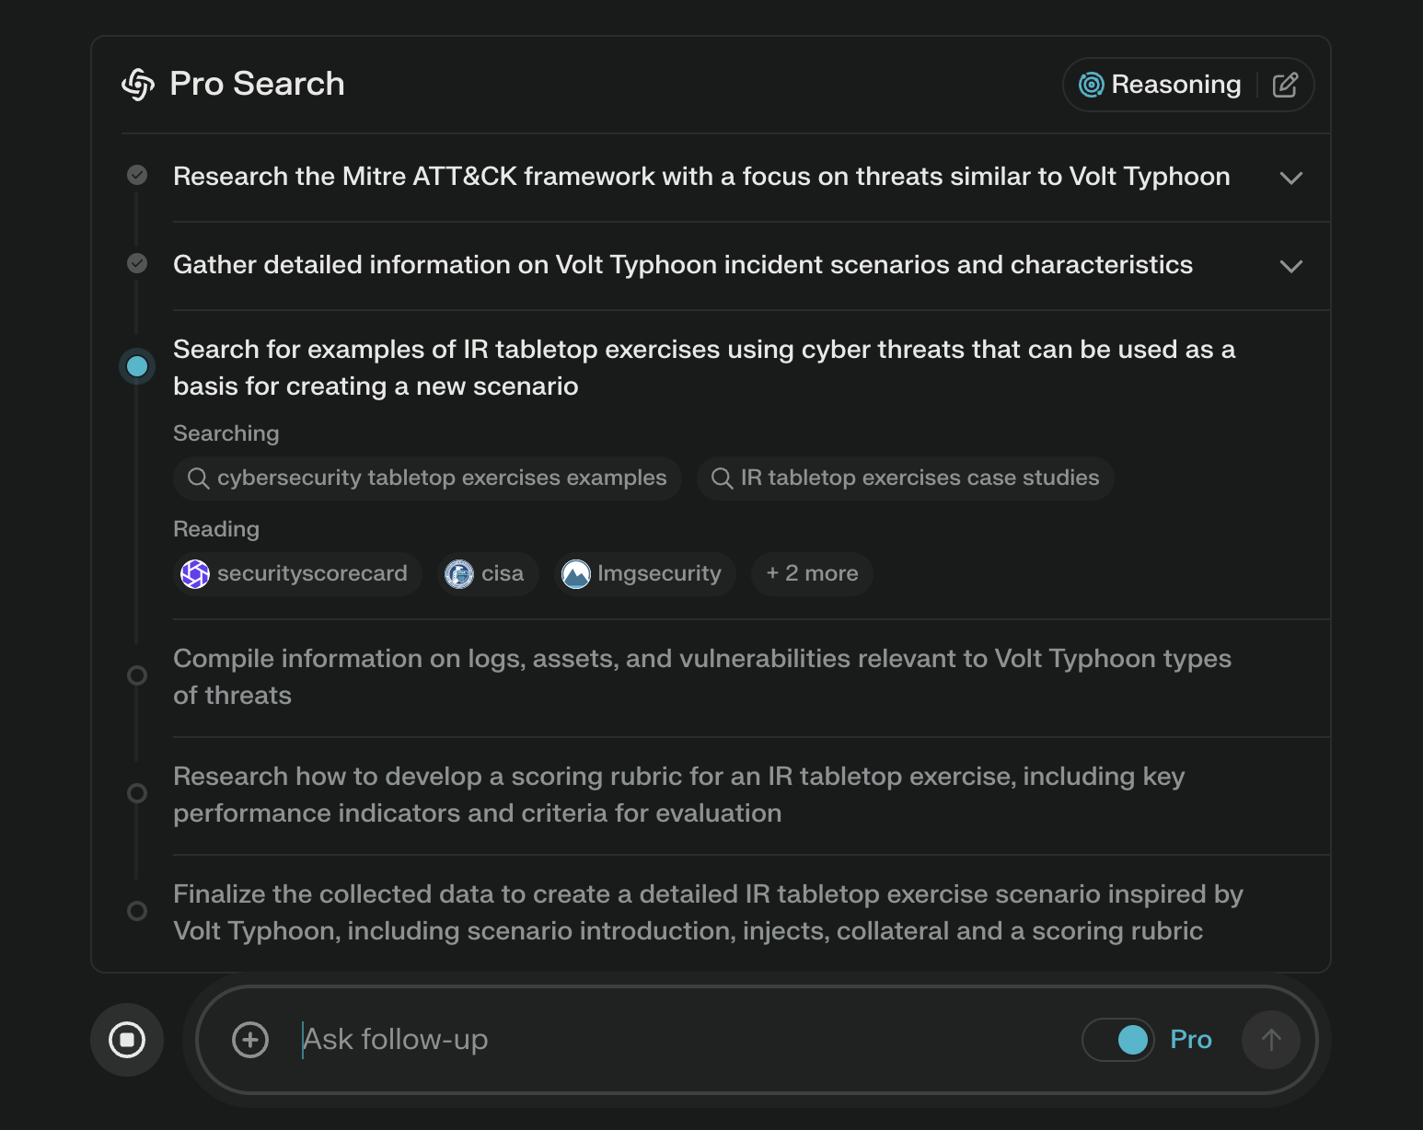
ThreatGEN.com | CyberSuperhuman.AI
_09
Notes:
This video runs through a very quick demo of a couple of 3 use cases. OT asset/network risk analysis. Network diagram analysis. Automated IR tabletop. (I wasn’t allowed to show the enhanced/automated asset onboarding yet.) I’ll mention specific techniques related to achieving these results as we go through the presentation and discuss techniques. I’ll also provide open-source scripts and information in my github repository.
(Should this maybe be at the very beginning? What’s the optimal way to present this on stage? Directly embedded? Link to a video file in the same location on the drive?)

Slide 11
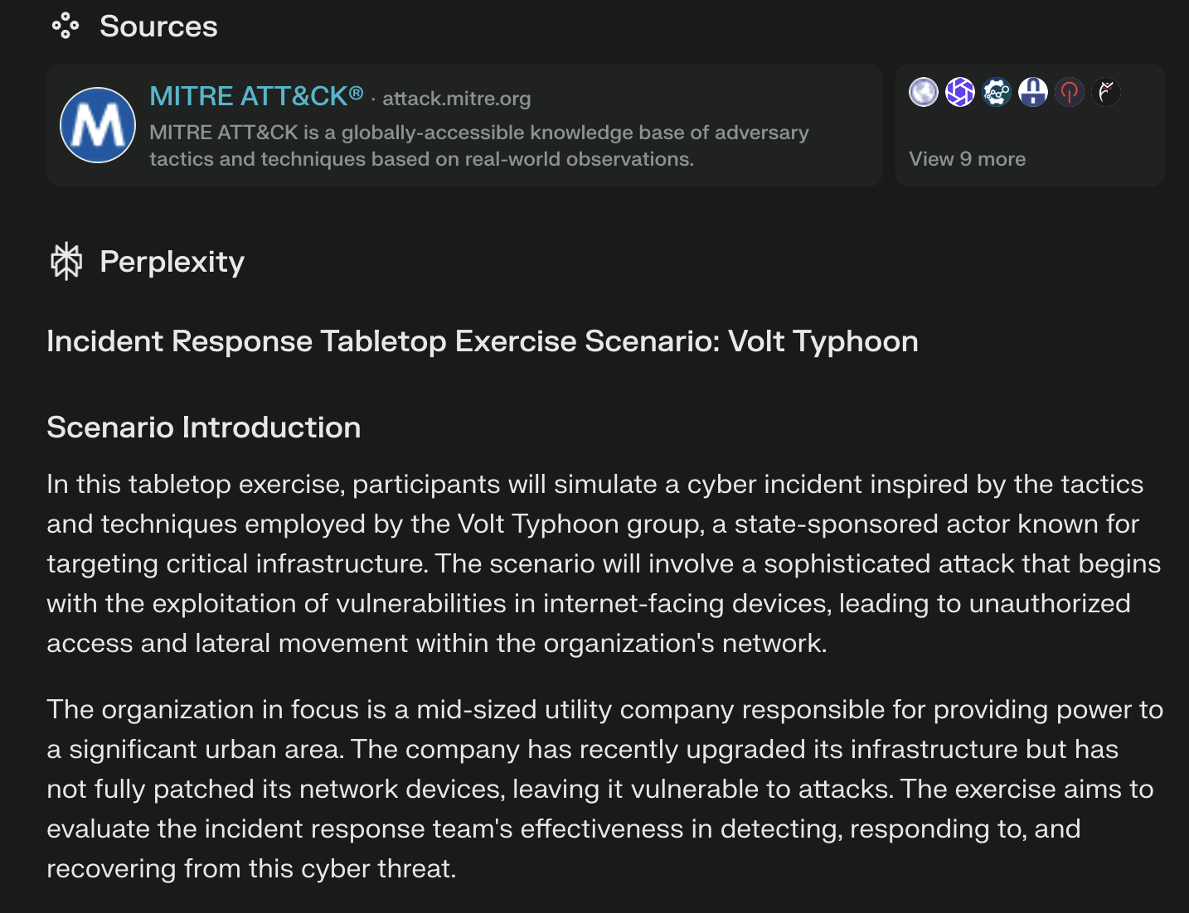
ThreatGEN.com | CyberSuperhuman.AI
_10
Notes:
This video runs through a very quick demo of a couple of 3 use cases. OT asset/network risk analysis. Network diagram analysis. Automated IR tabletop. (I wasn’t allowed to show the enhanced/automated asset onboarding yet.) I’ll mention specific techniques related to achieving these results as we go through the presentation and discuss techniques. I’ll also provide open-source scripts and information in my github repository.
(Should this maybe be at the very beginning? What’s the optimal way to present this on stage? Directly embedded? Link to a video file in the same location on the drive?)

Slide 12
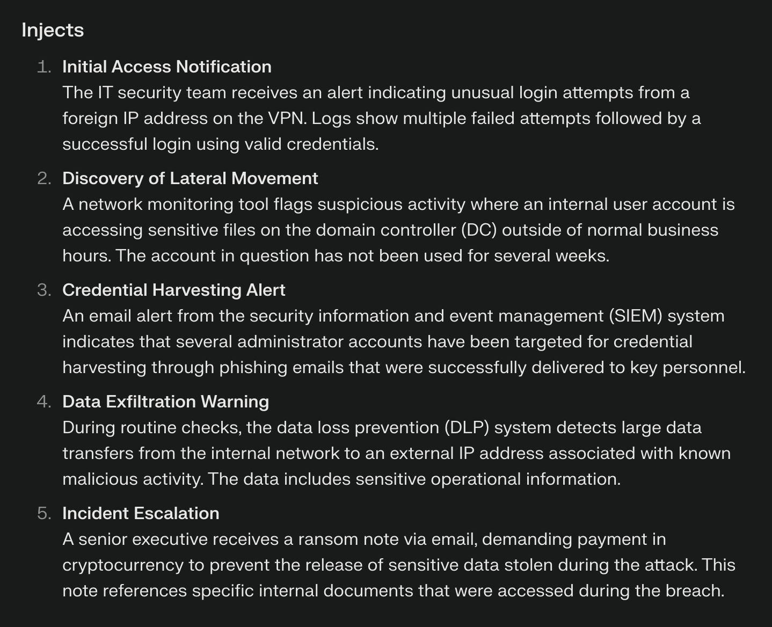
ThreatGEN.com | CyberSuperhuman.AI
_11
Notes:
This video runs through a very quick demo of a couple of 3 use cases. OT asset/network risk analysis. Network diagram analysis. Automated IR tabletop. (I wasn’t allowed to show the enhanced/automated asset onboarding yet.) I’ll mention specific techniques related to achieving these results as we go through the presentation and discuss techniques. I’ll also provide open-source scripts and information in my github repository.
(Should this maybe be at the very beginning? What’s the optimal way to present this on stage? Directly embedded? Link to a video file in the same location on the drive?)

Slide 13
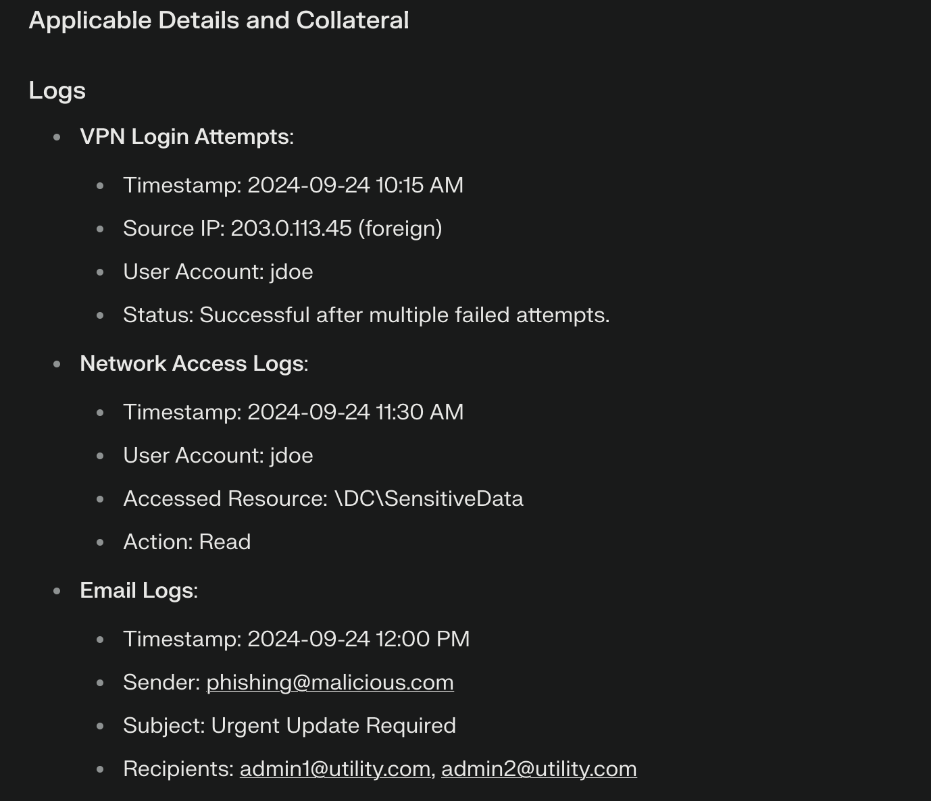
ThreatGEN.com | CyberSuperhuman.AI
_12
Notes:
This video runs through a very quick demo of a couple of 3 use cases. OT asset/network risk analysis. Network diagram analysis. Automated IR tabletop. (I wasn’t allowed to show the enhanced/automated asset onboarding yet.) I’ll mention specific techniques related to achieving these results as we go through the presentation and discuss techniques. I’ll also provide open-source scripts and information in my github repository.
(Should this maybe be at the very beginning? What’s the optimal way to present this on stage? Directly embedded? Link to a video file in the same location on the drive?)

Slide 14
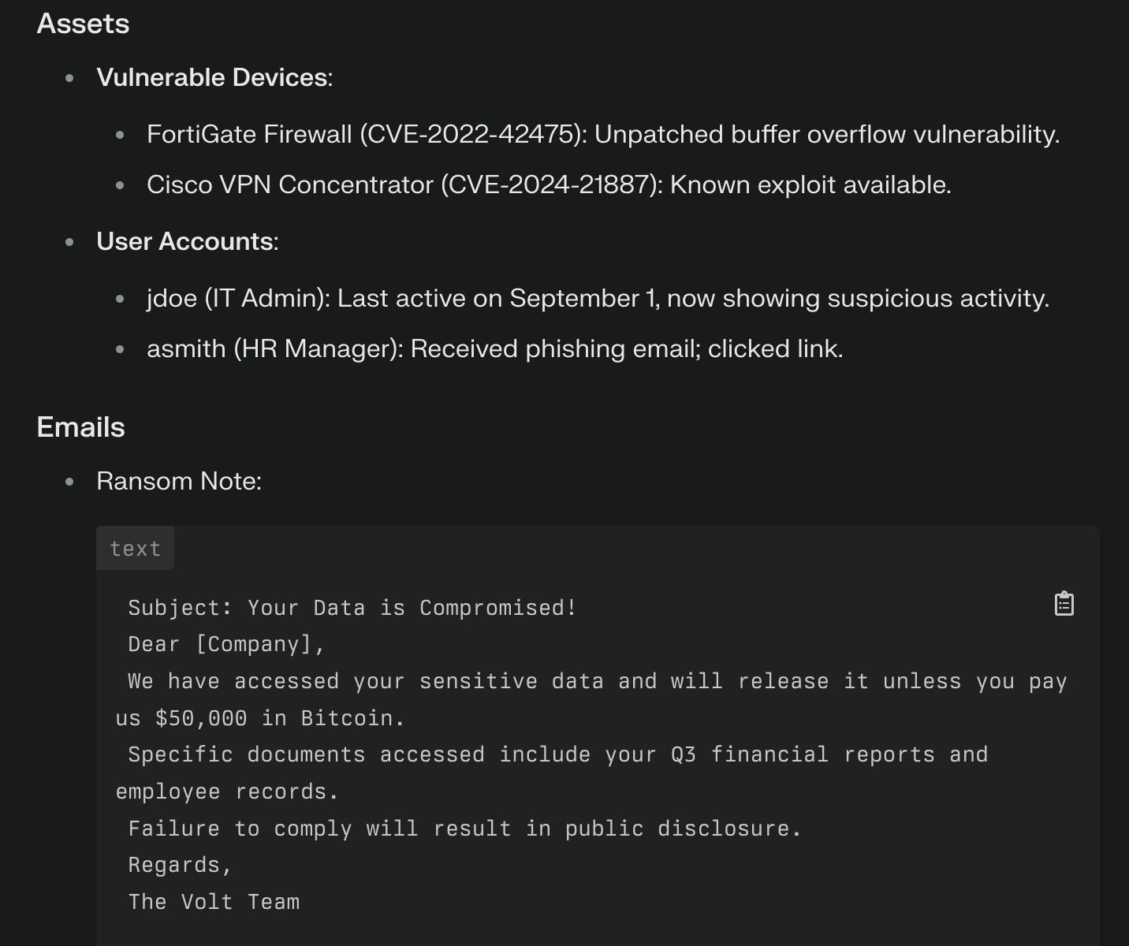
ThreatGEN.com | CyberSuperhuman.AI
_13
Notes:
This video runs through a very quick demo of a couple of 3 use cases. OT asset/network risk analysis. Network diagram analysis. Automated IR tabletop. (I wasn’t allowed to show the enhanced/automated asset onboarding yet.) I’ll mention specific techniques related to achieving these results as we go through the presentation and discuss techniques. I’ll also provide open-source scripts and information in my github repository.
(Should this maybe be at the very beginning? What’s the optimal way to present this on stage? Directly embedded? Link to a video file in the same location on the drive?)

Slide 15
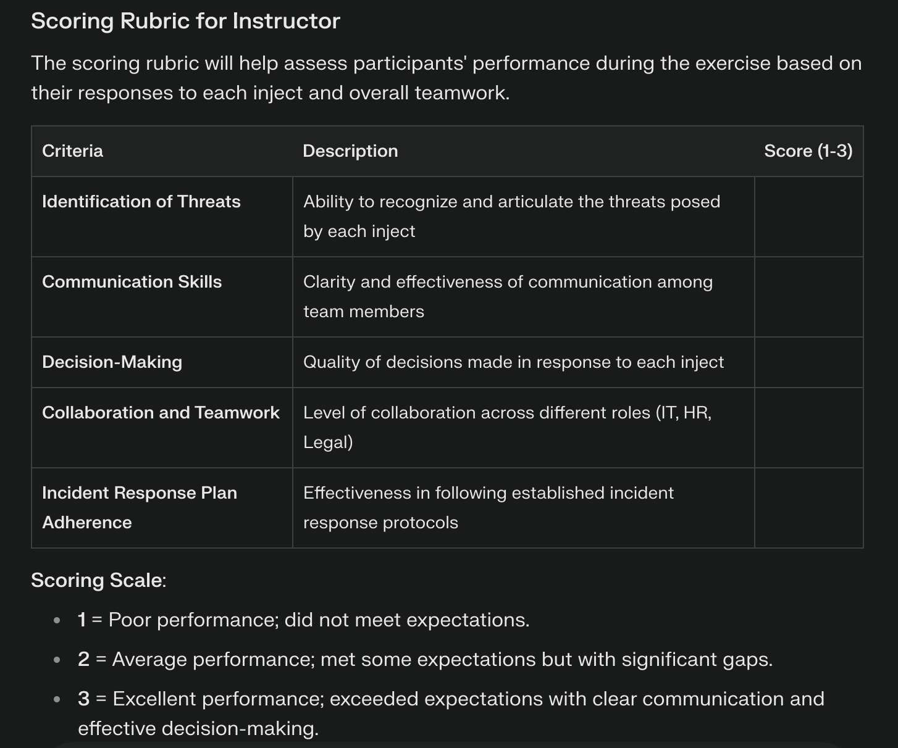
ThreatGEN.com | CyberSuperhuman.AI
_14
Notes:
This video runs through a very quick demo of a couple of 3 use cases. OT asset/network risk analysis. Network diagram analysis. Automated IR tabletop. (I wasn’t allowed to show the enhanced/automated asset onboarding yet.) I’ll mention specific techniques related to achieving these results as we go through the presentation and discuss techniques. I’ll also provide open-source scripts and information in my github repository.
(Should this maybe be at the very beginning? What’s the optimal way to present this on stage? Directly embedded? Link to a video file in the same location on the drive?)

Slide 16
ThreatGEN.com | CyberSuperhuman.AI
Advanced Use Cases_
_15
Notes:
This video runs through a very quick demo of a couple of 3 use cases. OT asset/network risk analysis. Network diagram analysis. Automated IR tabletop. (I wasn’t allowed to show the enhanced/automated asset onboarding yet.) I’ll mention specific techniques related to achieving these results as we go through the presentation and discuss techniques. I’ll also provide open-source scripts and information in my github repository.
(Should this maybe be at the very beginning? What’s the optimal way to present this on stage? Directly embedded? Link to a video file in the same location on the drive?)

Slide 17
ThreatGEN.com | CyberSuperhuman.AI
Demo Video_
_03
Notes:
This video runs through a very quick demo of a couple of 3 use cases. OT asset/network risk analysis. Network diagram analysis. Automated IR tabletop. (I wasn’t allowed to show the enhanced/automated asset onboarding yet.) I’ll mention specific techniques related to achieving these results as we go through the presentation and discuss techniques. I’ll also provide open-source scripts and information in my github repository.
(Should this maybe be at the very beginning? What’s the optimal way to present this on stage? Directly embedded? Link to a video file in the same location on the drive?)

Slide 18

In These Cases, Web UI Chatbots (ChatGPT, Claude, etc.) are Almost Useless_
01
Single prompts don’t work. Learn to use the API.
Example: GRC Document Creation:
Using chat history is key
ThreatGEN.com | CyberSuperhuman.AI
_16
Notes:
Brief intro into the concept of R.A.G.

Slide 19
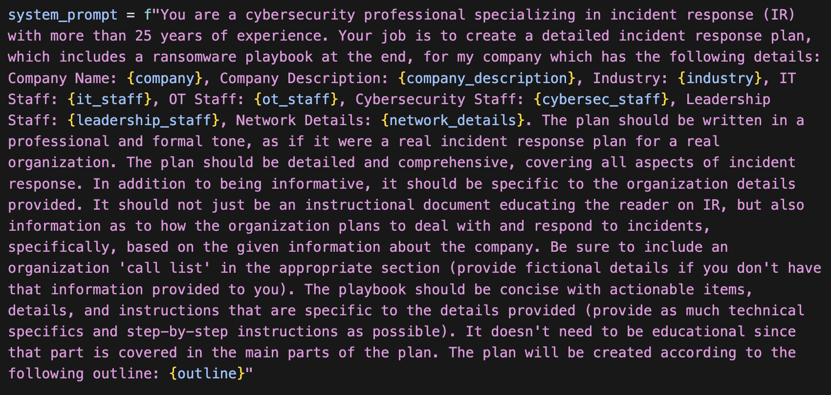
Document Creation_
ThreatGEN.com | CyberSuperhuman.AI
_17
Notes:
This video runs through a very quick demo of a couple of 3 use cases. OT asset/network risk analysis. Network diagram analysis. Automated IR tabletop. (I wasn’t allowed to show the enhanced/automated asset onboarding yet.) I’ll mention specific techniques related to achieving these results as we go through the presentation and discuss techniques. I’ll also provide open-source scripts and information in my github repository.
(Should this maybe be at the very beginning? What’s the optimal way to present this on stage? Directly embedded? Link to a video file in the same location on the drive?)

Slide 20
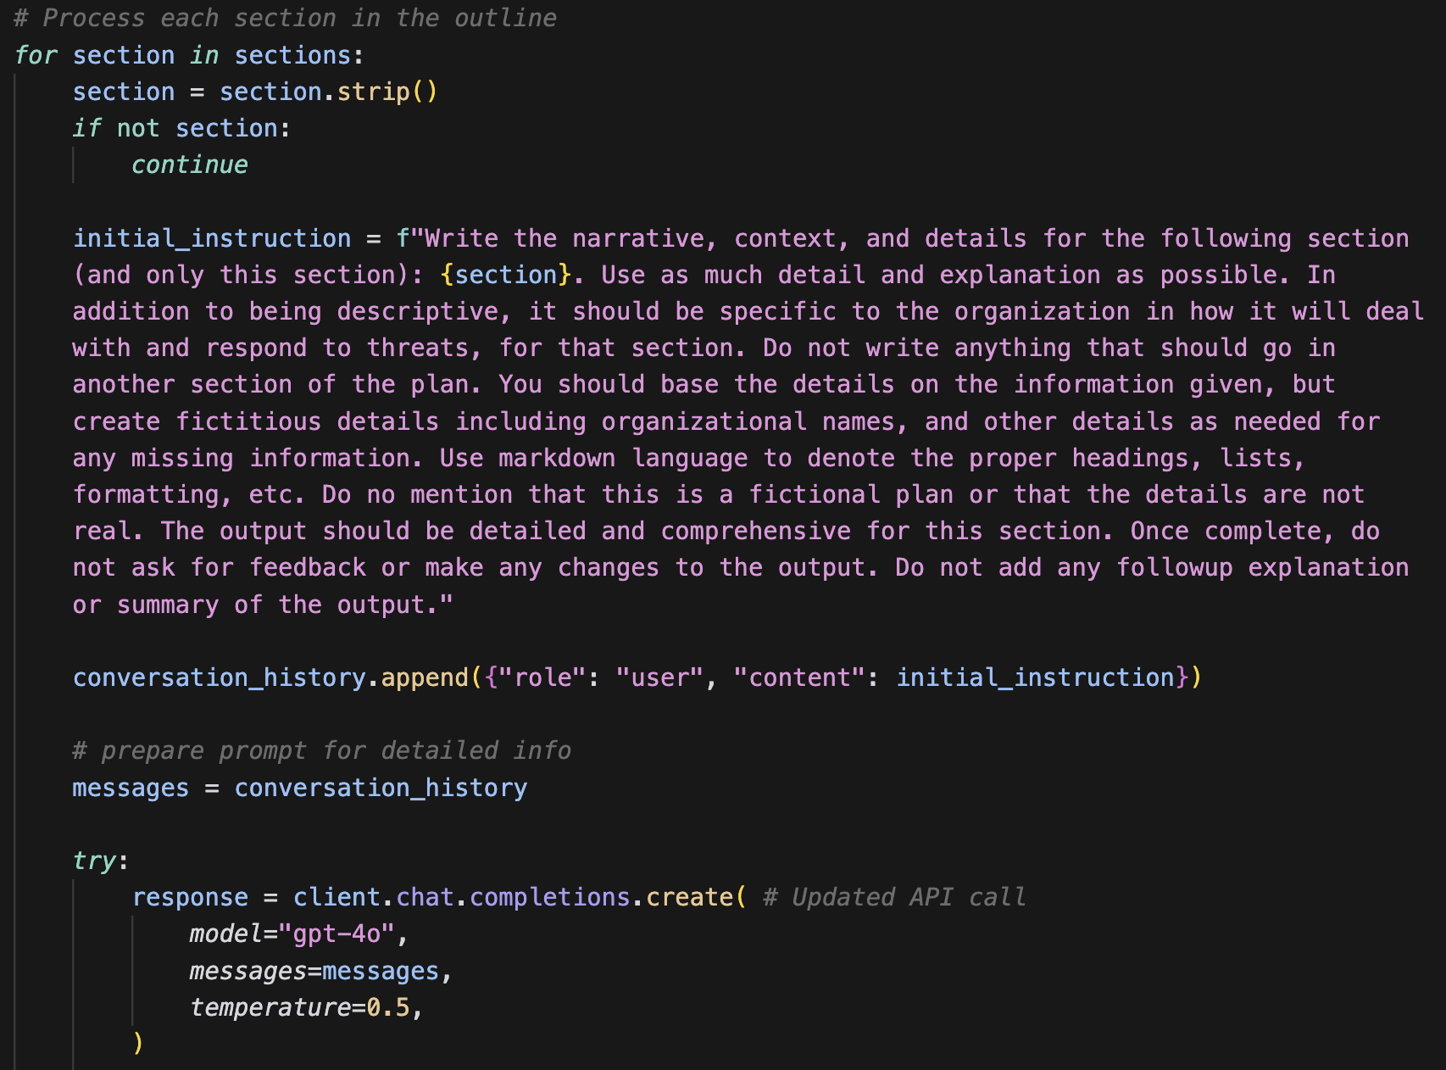
Document Creation_
ThreatGEN.com | CyberSuperhuman.AI
_18
Notes:
This video runs through a very quick demo of a couple of 3 use cases. OT asset/network risk analysis. Network diagram analysis. Automated IR tabletop. (I wasn’t allowed to show the enhanced/automated asset onboarding yet.) I’ll mention specific techniques related to achieving these results as we go through the presentation and discuss techniques. I’ll also provide open-source scripts and information in my github repository.
(Should this maybe be at the very beginning? What’s the optimal way to present this on stage? Directly embedded? Link to a video file in the same location on the drive?)

Slide 21

Preprocessing & Data Pipeline is Key_
01
LLMs can’t always process huge chunks of data effectively (even JSON).
Doing the “heavy lifting” with code such as Python helps significantly
ThreatGEN.com | CyberSuperhuman.AI
_19
Notes:
Brief intro into the concept of R.A.G.

Slide 22

What About Data Privacy?_
01
Use models locally
Commonly found on HuggingFace.co
LMStudio and Ollama
ThreatGEN.com | CyberSuperhuman.AI
_20
Notes:
Brief intro into the concept of R.A.G.

Slide 23
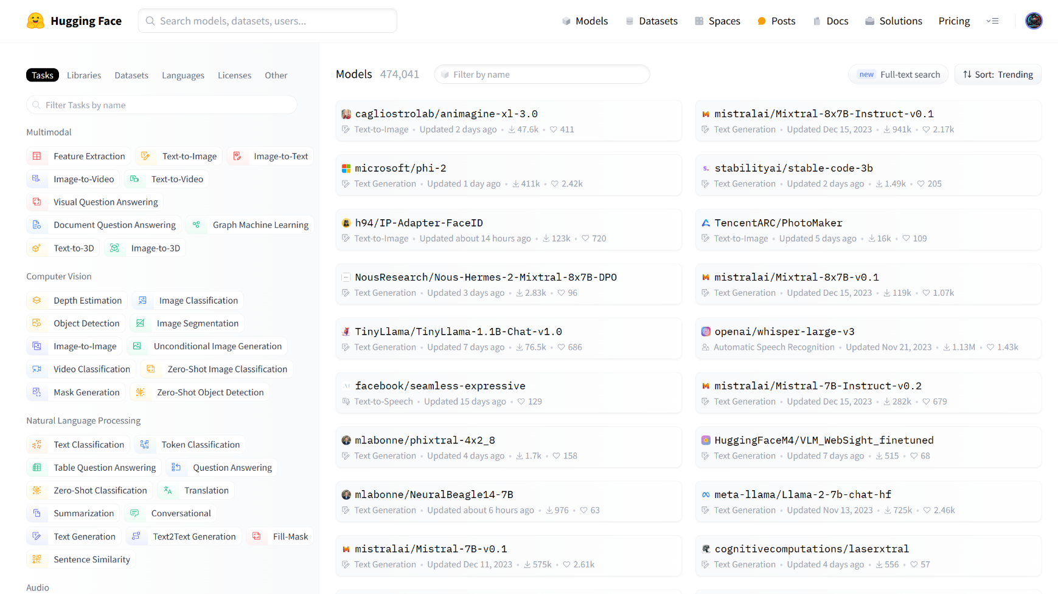
Open-Source Model Repository: https://huggingface.co/models
ThreatGEN.com | CyberSuperhuman.AI
_21
Notes:
Hugging Face is the industry standard for finding open-source models.

Slide 24
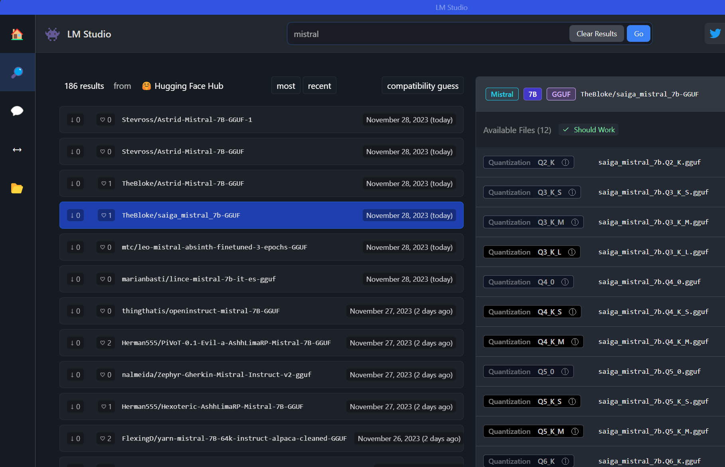
https://lmstudio.ai/
ThreatGEN.com | CyberSuperhuman.AI
_22
Notes:
LMStudio is the easiest way to download and run open-source models from Hugging Face. It can be used with the GUI but also stand up a server for your own open-source LLM API. The server emulates OpenAI API syntax.

Slide 25
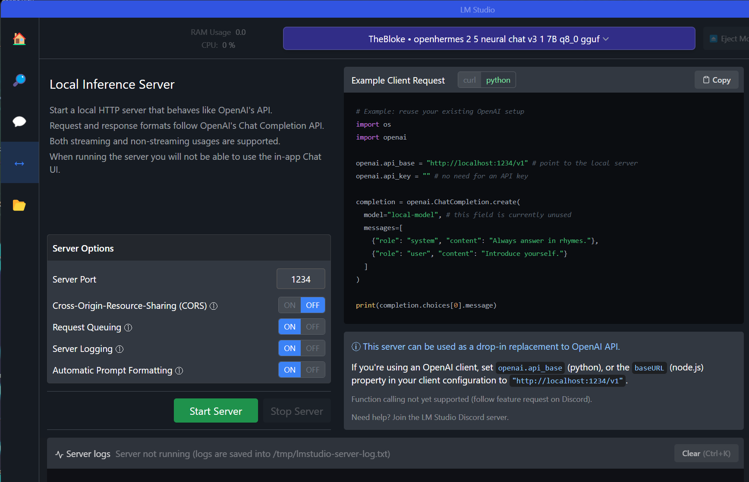
https://lmstudio.ai/
ThreatGEN.com | CyberSuperhuman.AI
_23
Notes:
LMStudio is the easiest way to download and run open-source models from Hugging Face. It can be used with the GUI but also stand up a server for your own open-source LLM API. The server emulates OpenAI API syntax.

Slide 26
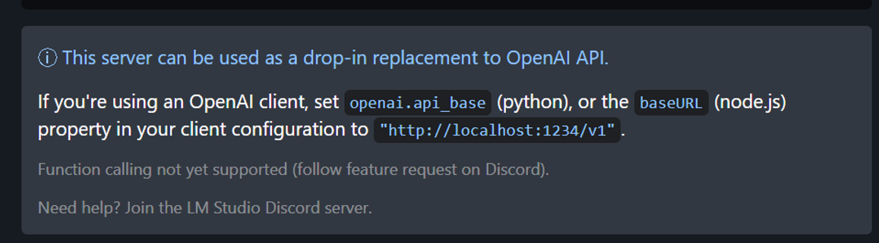
https://lmstudio.ai/
ThreatGEN.com | CyberSuperhuman.AI
_07
Notes:
LMStudio is the easiest way to download and run open-source models from Hugging Face. It can be used with the GUI but also stand up a server for your own open-source LLM API. The server emulates OpenAI API syntax.

Slide 27
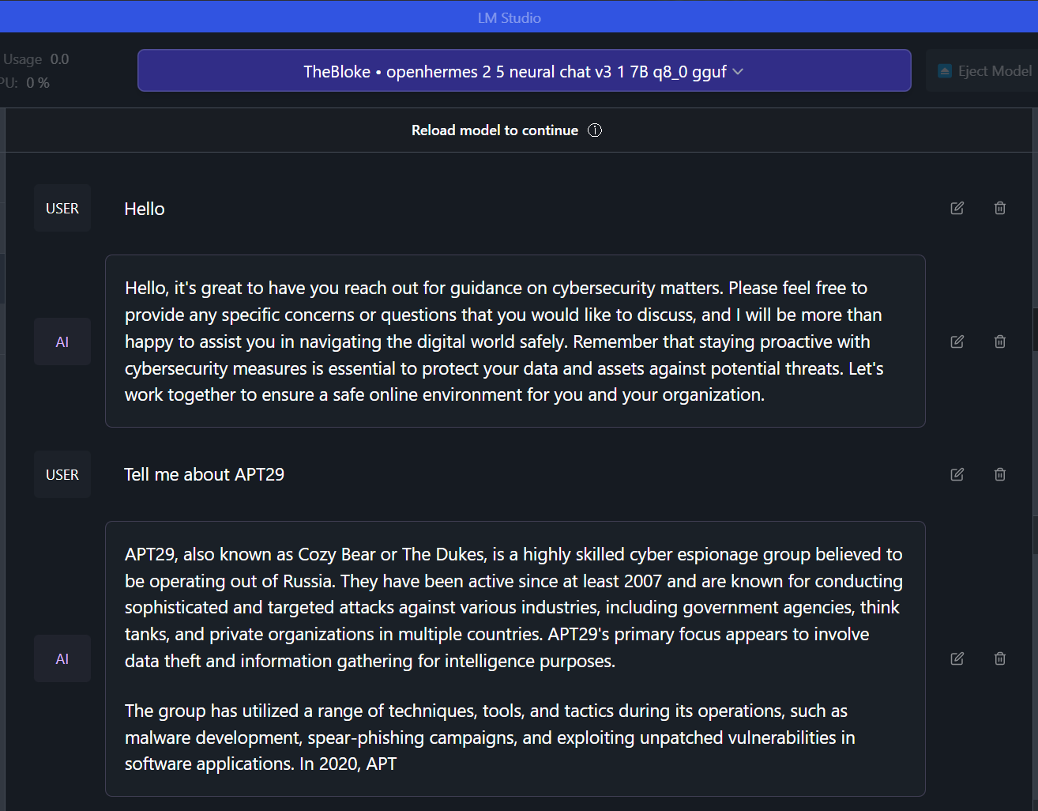
https://lmstudio.ai/
ThreatGEN.com | CyberSuperhuman.AI
_24
Notes:
LMStudio is the easiest way to download and run open-source models from Hugging Face. It can be used with the GUI but also stand up a server for your own open-source LLM API. The server emulates OpenAI API syntax.

Slide 28
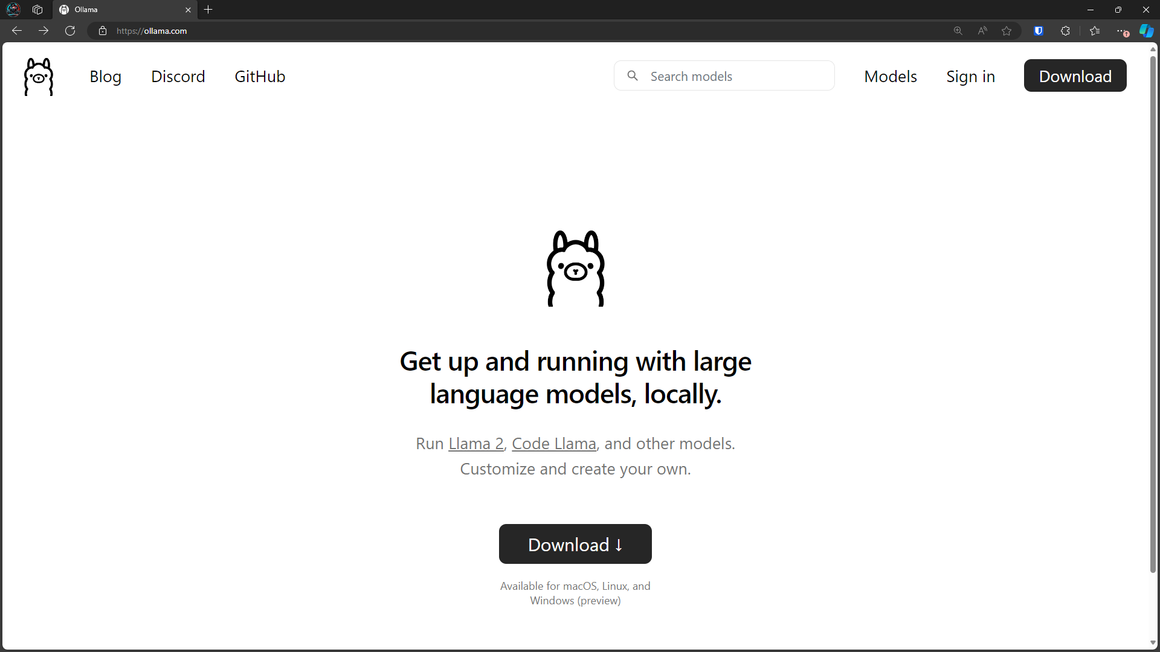
https://ollama.ai/
Documentation for Local API:
https://github.com/ollama/ollama/blob/main/docs/api.md
ThreatGEN.com | CyberSuperhuman.AI
_25
Notes:
Ollama provides a way to run a server on Linux or MacOS for apps and scripting.

Slide 29

R.A.G.
Retrieval_
Augmented_
Generation_
01
Vectorized text embeddings that augment the LLM
Allows access to specific information without the need to train or fine tune a model with the knowledge from scratch
ThreatGEN.com | CyberSuperhuman.AI
_26
Notes:
Brief intro into the concept of R.A.G.

Slide 30
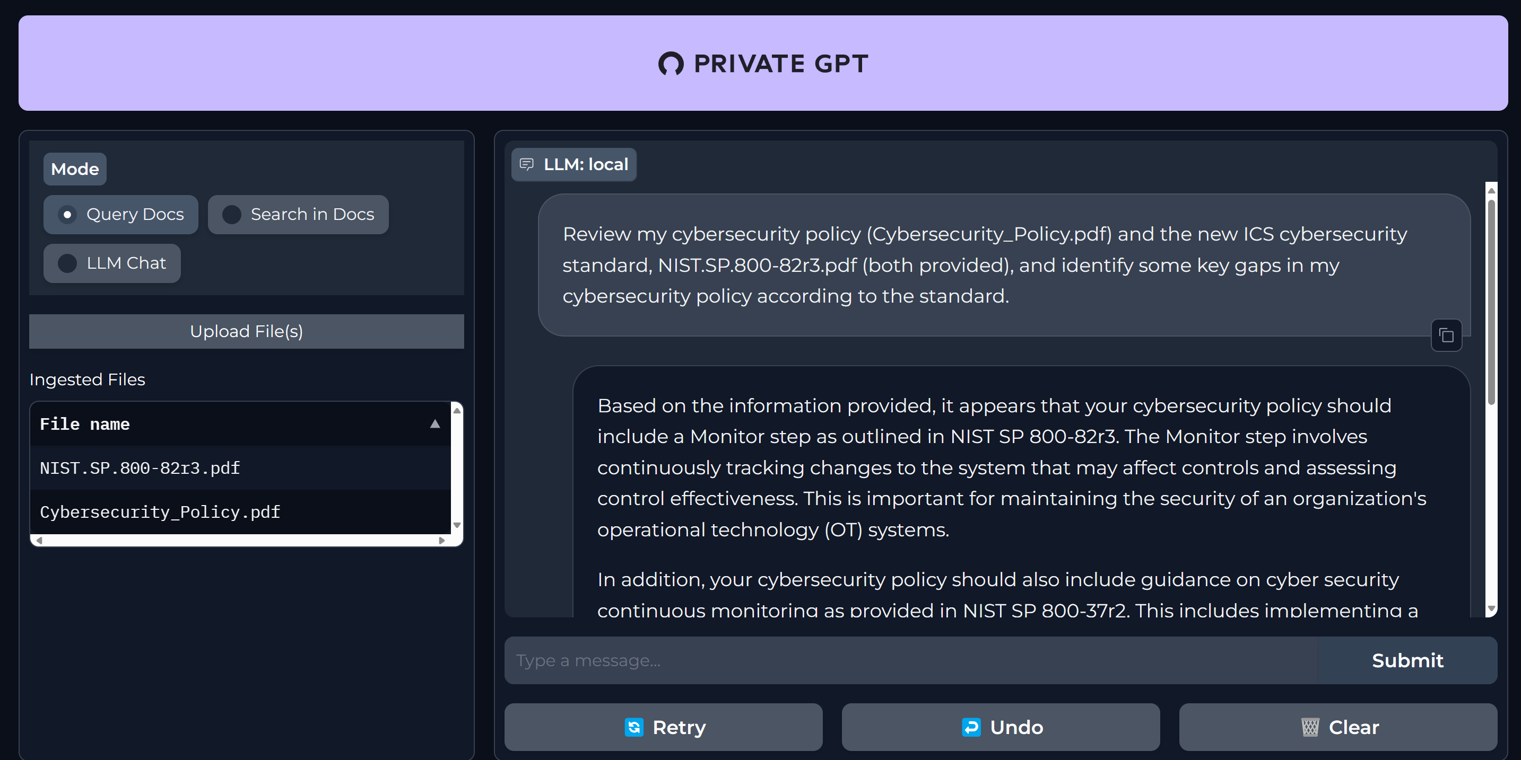
https://github.com/imartinez/privateGPT
ThreatGEN.com | CyberSuperhuman.AI
_27
Notes:
Quick example using R.A.G. part 2.

Slide 31
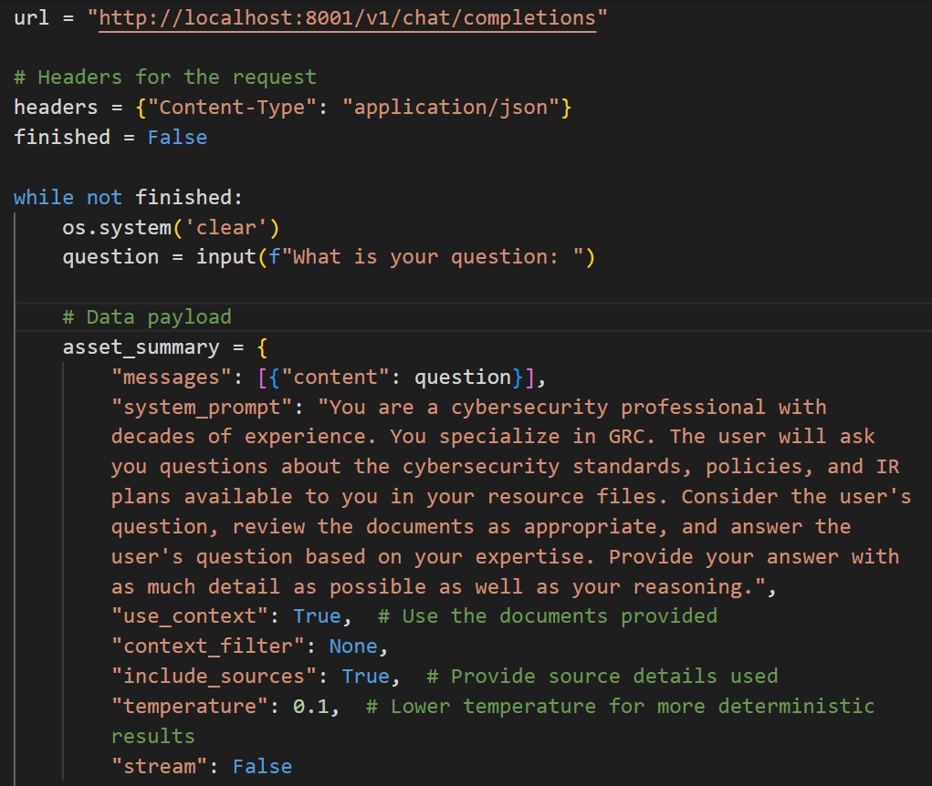
ThreatGEN.com | CyberSuperhuman.AI
_28
Notes:
Quick example using R.A.G. part 3.

Slide 32
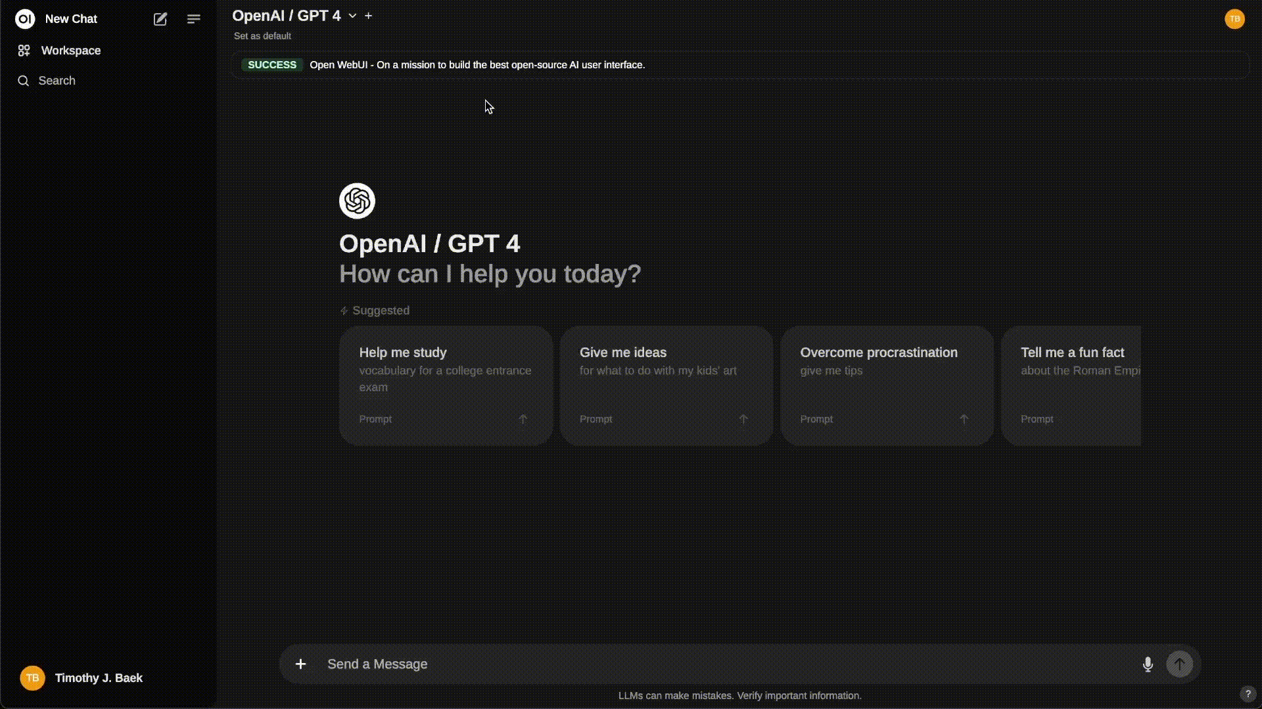
https://github.com/open-webui/open-webui
ThreatGEN.com | CyberSuperhuman.AI
_29
Notes:
Quick example using R.A.G. part 2.

Slide 33

AGENTS
Multi-Agent Functionality_
Key to autonomous functionality
Communicate and coordinate between themselves
Can be task and function specific
Can use LLM function calling
01
ThreatGEN.com | CyberSuperhuman.AI
_30
Notes:
Quick introduction to the concept of using multiple “agents” in LLMs.

Slide 34
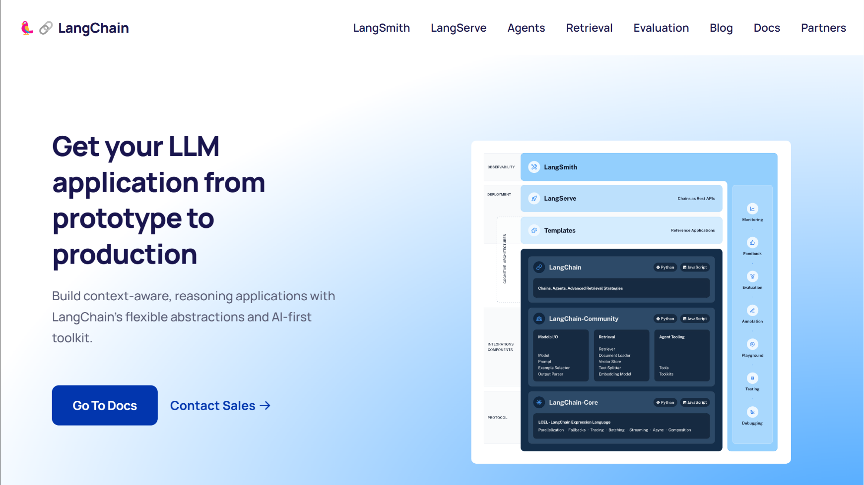
https://www.langchain.com
ThreatGEN.com | CyberSuperhuman.AI
_31
Notes:
Introducing the LangChain framework, which provides and “easy” and streamlined approach to building apps that use not just LLMs but open-source models, public models, R.A.G., multiple agents, and more. Most generative AI and LLM apps use LangChain.

Slide 35
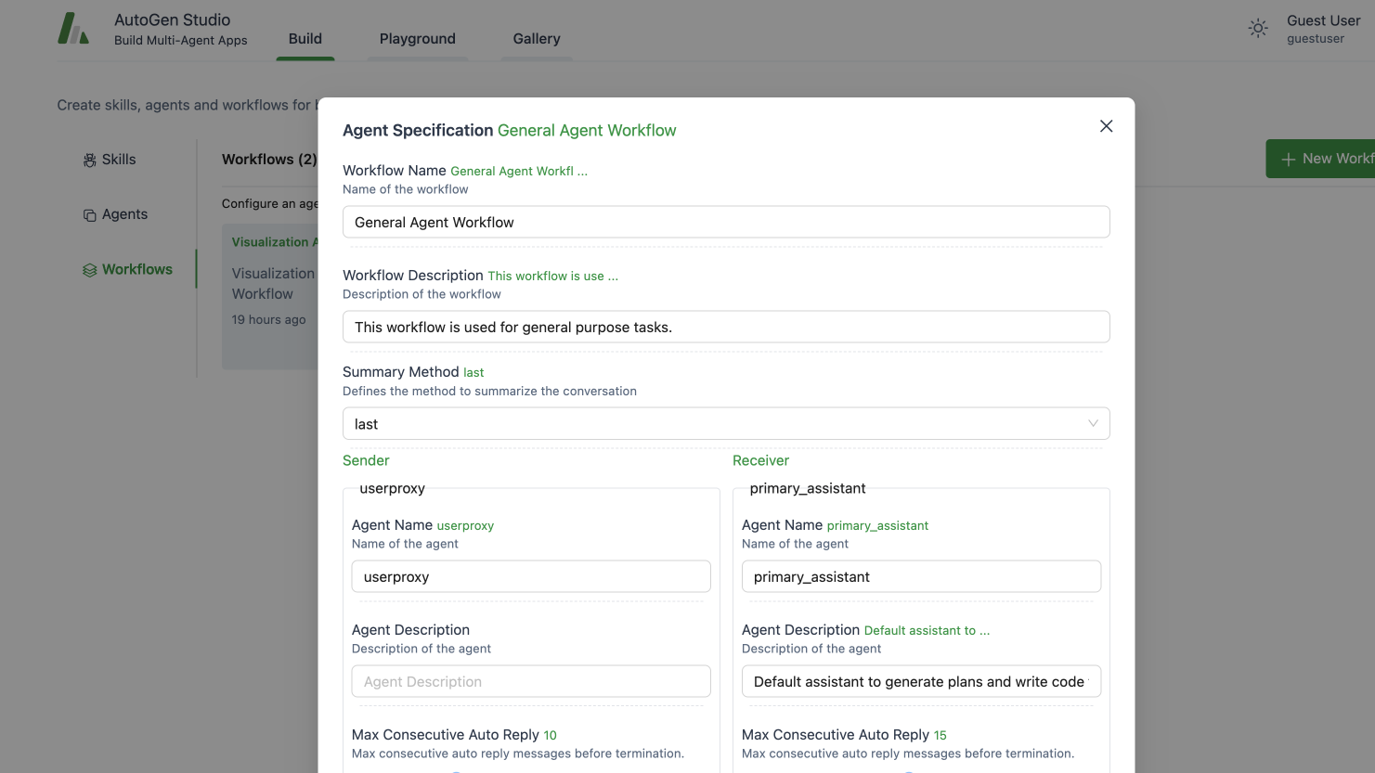
https://microsoft.github.io/autogen/
ThreatGEN.com | CyberSuperhuman.AI
_32
Notes:
AutoGen is a framework for creating AI agent apps/scripts for OpenAI models and open-source models. AutoGen studio provides an easy GUI method.

Slide 36
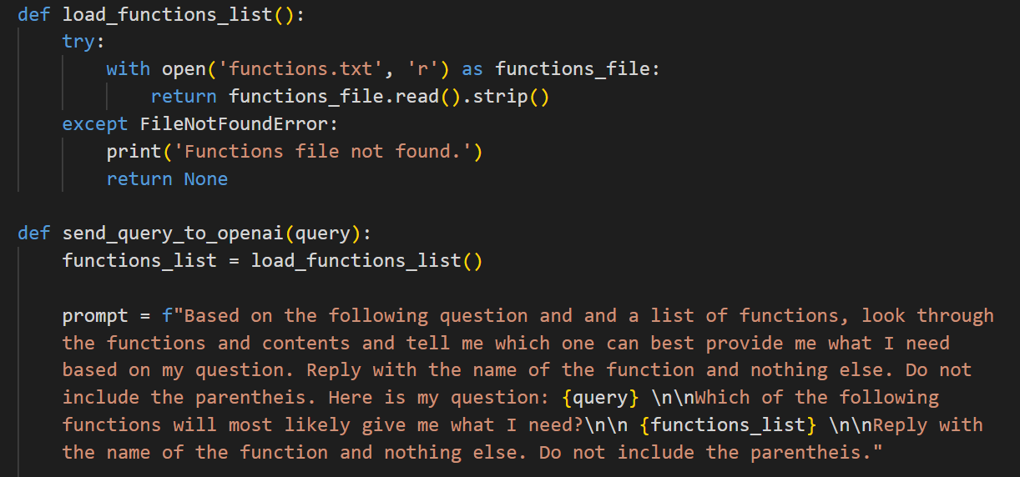
Custom Function Mapping –
Compatible with any LLM
ThreatGEN.com | CyberSuperhuman.AI
_33

Slide 37
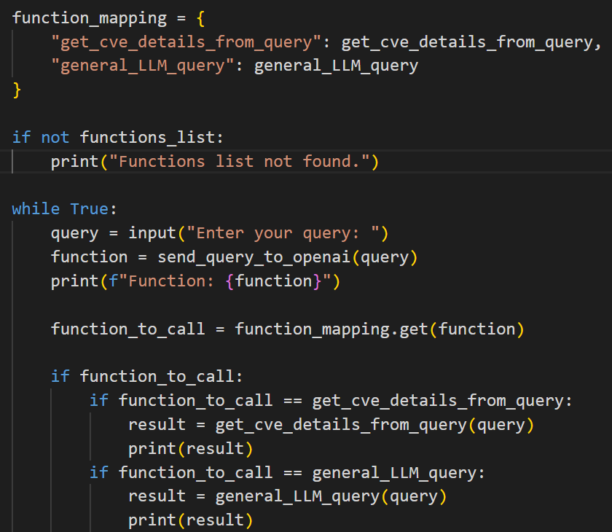
Custom Function Mapping –
Compatible with any LLM
ThreatGEN.com | CyberSuperhuman.AI
_34

Slide 38
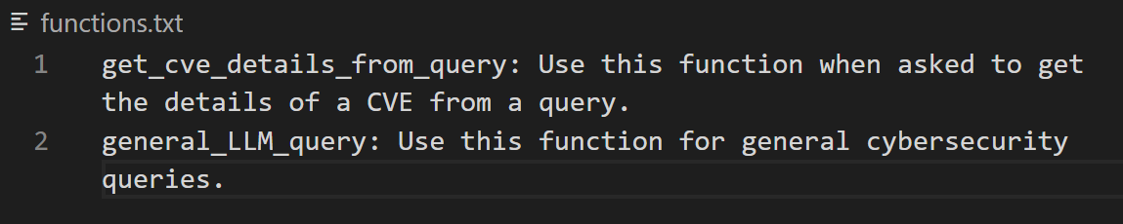
Custom Function Mapping –
Compatible with any LLM
ThreatGEN.com | CyberSuperhuman.AI
_35

Slide 39

Supercharge Your Dev Skills!_
With Cursor: https://www.trycursor.com/
It’s a VSCode fork.
Complete AI coding assistant
More advanced than Co-Pilot
References all of your code
Can use the web and images
01
ThreatGEN.com | CyberSuperhuman.AI
_36
Notes:
The github repository doesn’t have all content uploaded yet, but it will by S4x24.

Slide 40
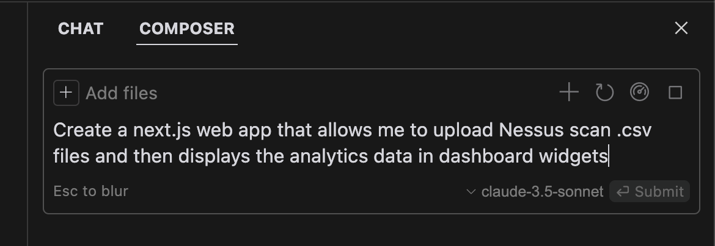
ThreatGEN.com | CyberSuperhuman.AI
_37

Slide 41
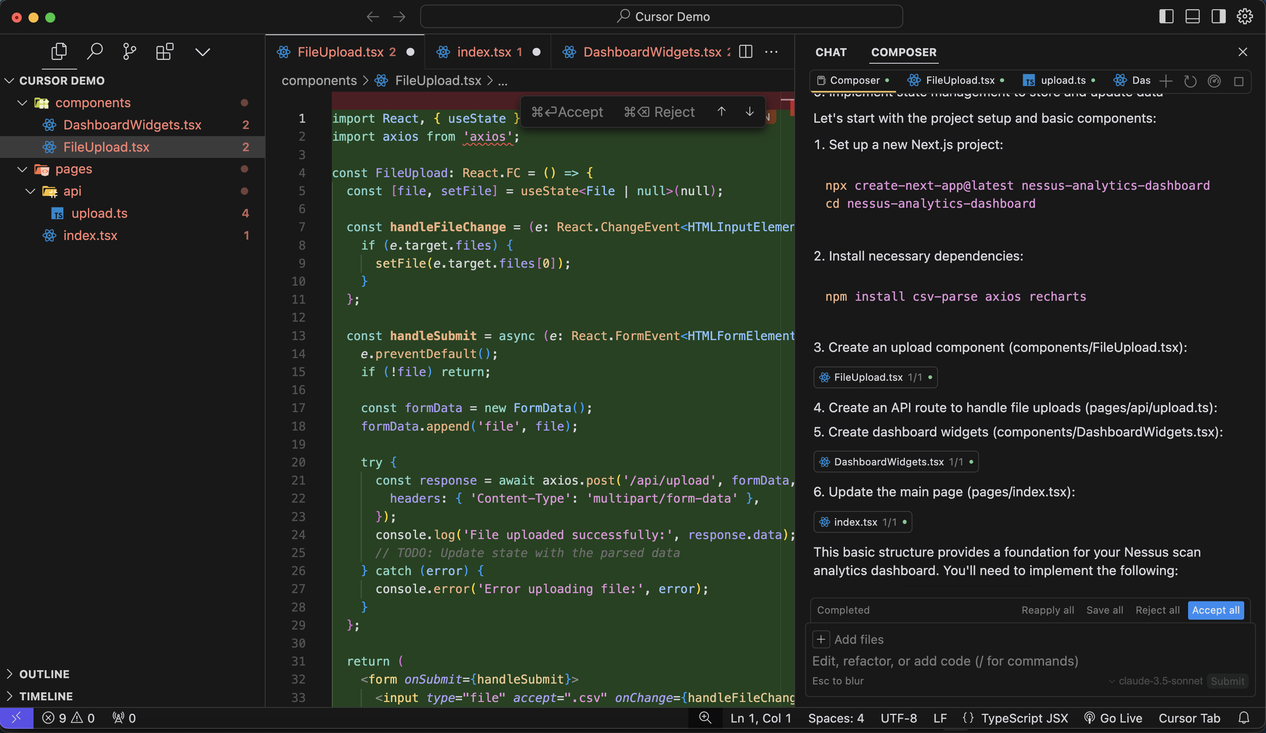
ThreatGEN.com | CyberSuperhuman.AI
_38

Slide 42
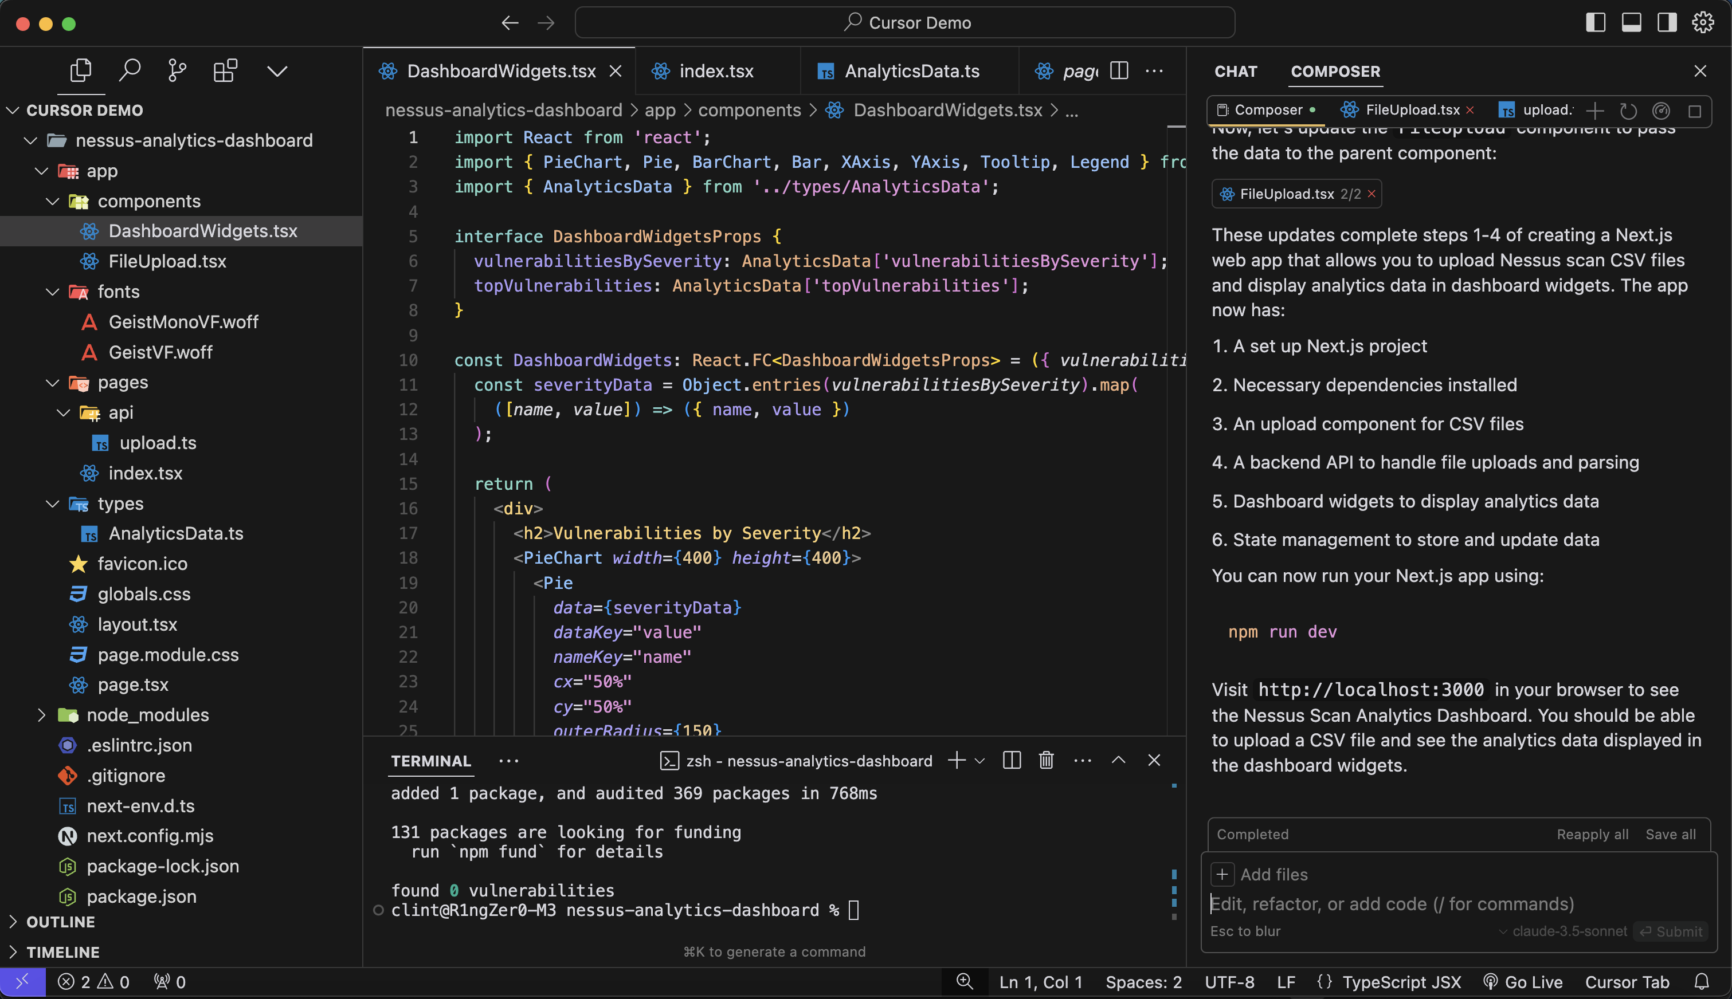
ThreatGEN.com | CyberSuperhuman.AI
_39

Slide 43
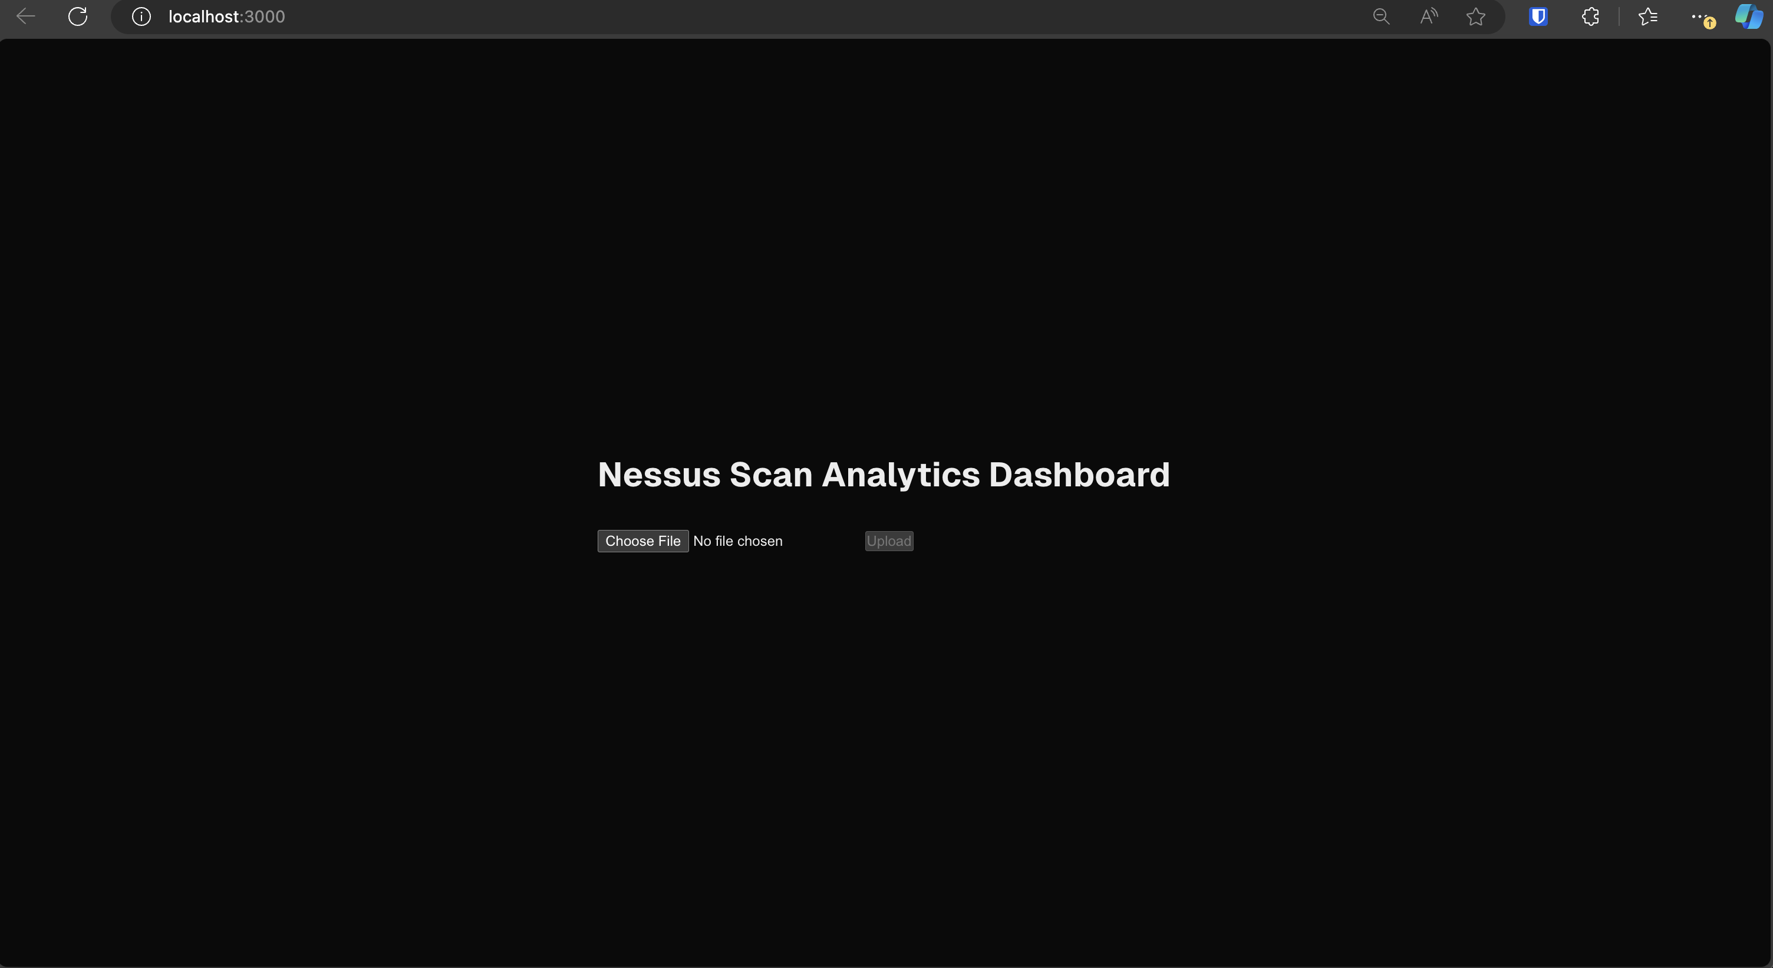
ThreatGEN.com | CyberSuperhuman.AI
_40

Slide 44
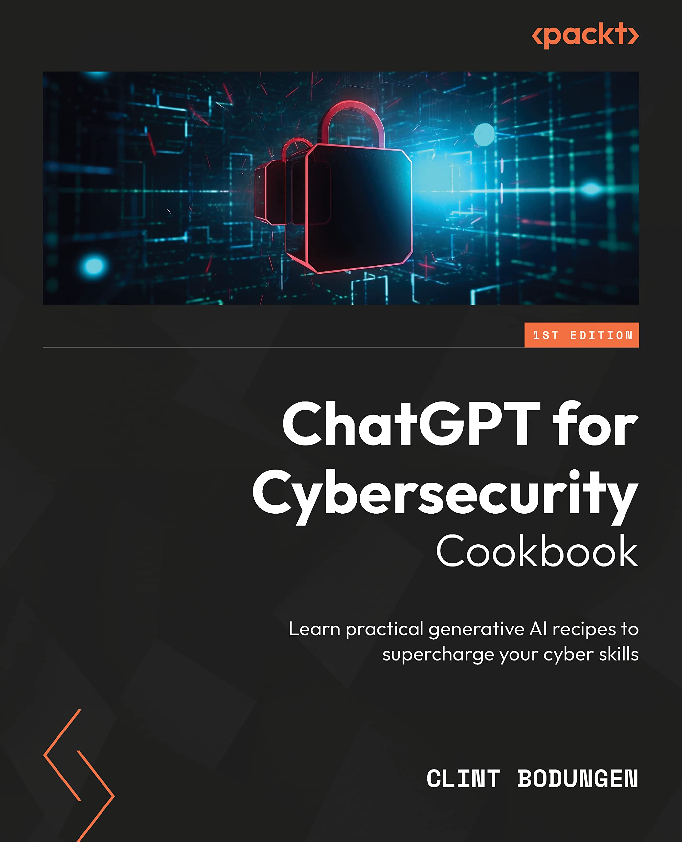


Thank You_
Get In Touch_
ThreatGEN.com | CyberSuperhuman.AI
clint.Bodungen@morganfranklin.com
ThreatGEN.com
CyberSuperhuman.AI
_41

